Slide 1
PLanetary health and the Great Transition
Teddie Potter PhD, RN, FAAN, FNAP
Director of Planetary Health
School of Nursing, University of Minnesota

Slide 3
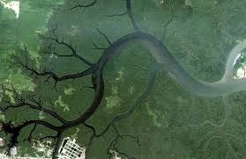

Slide 7
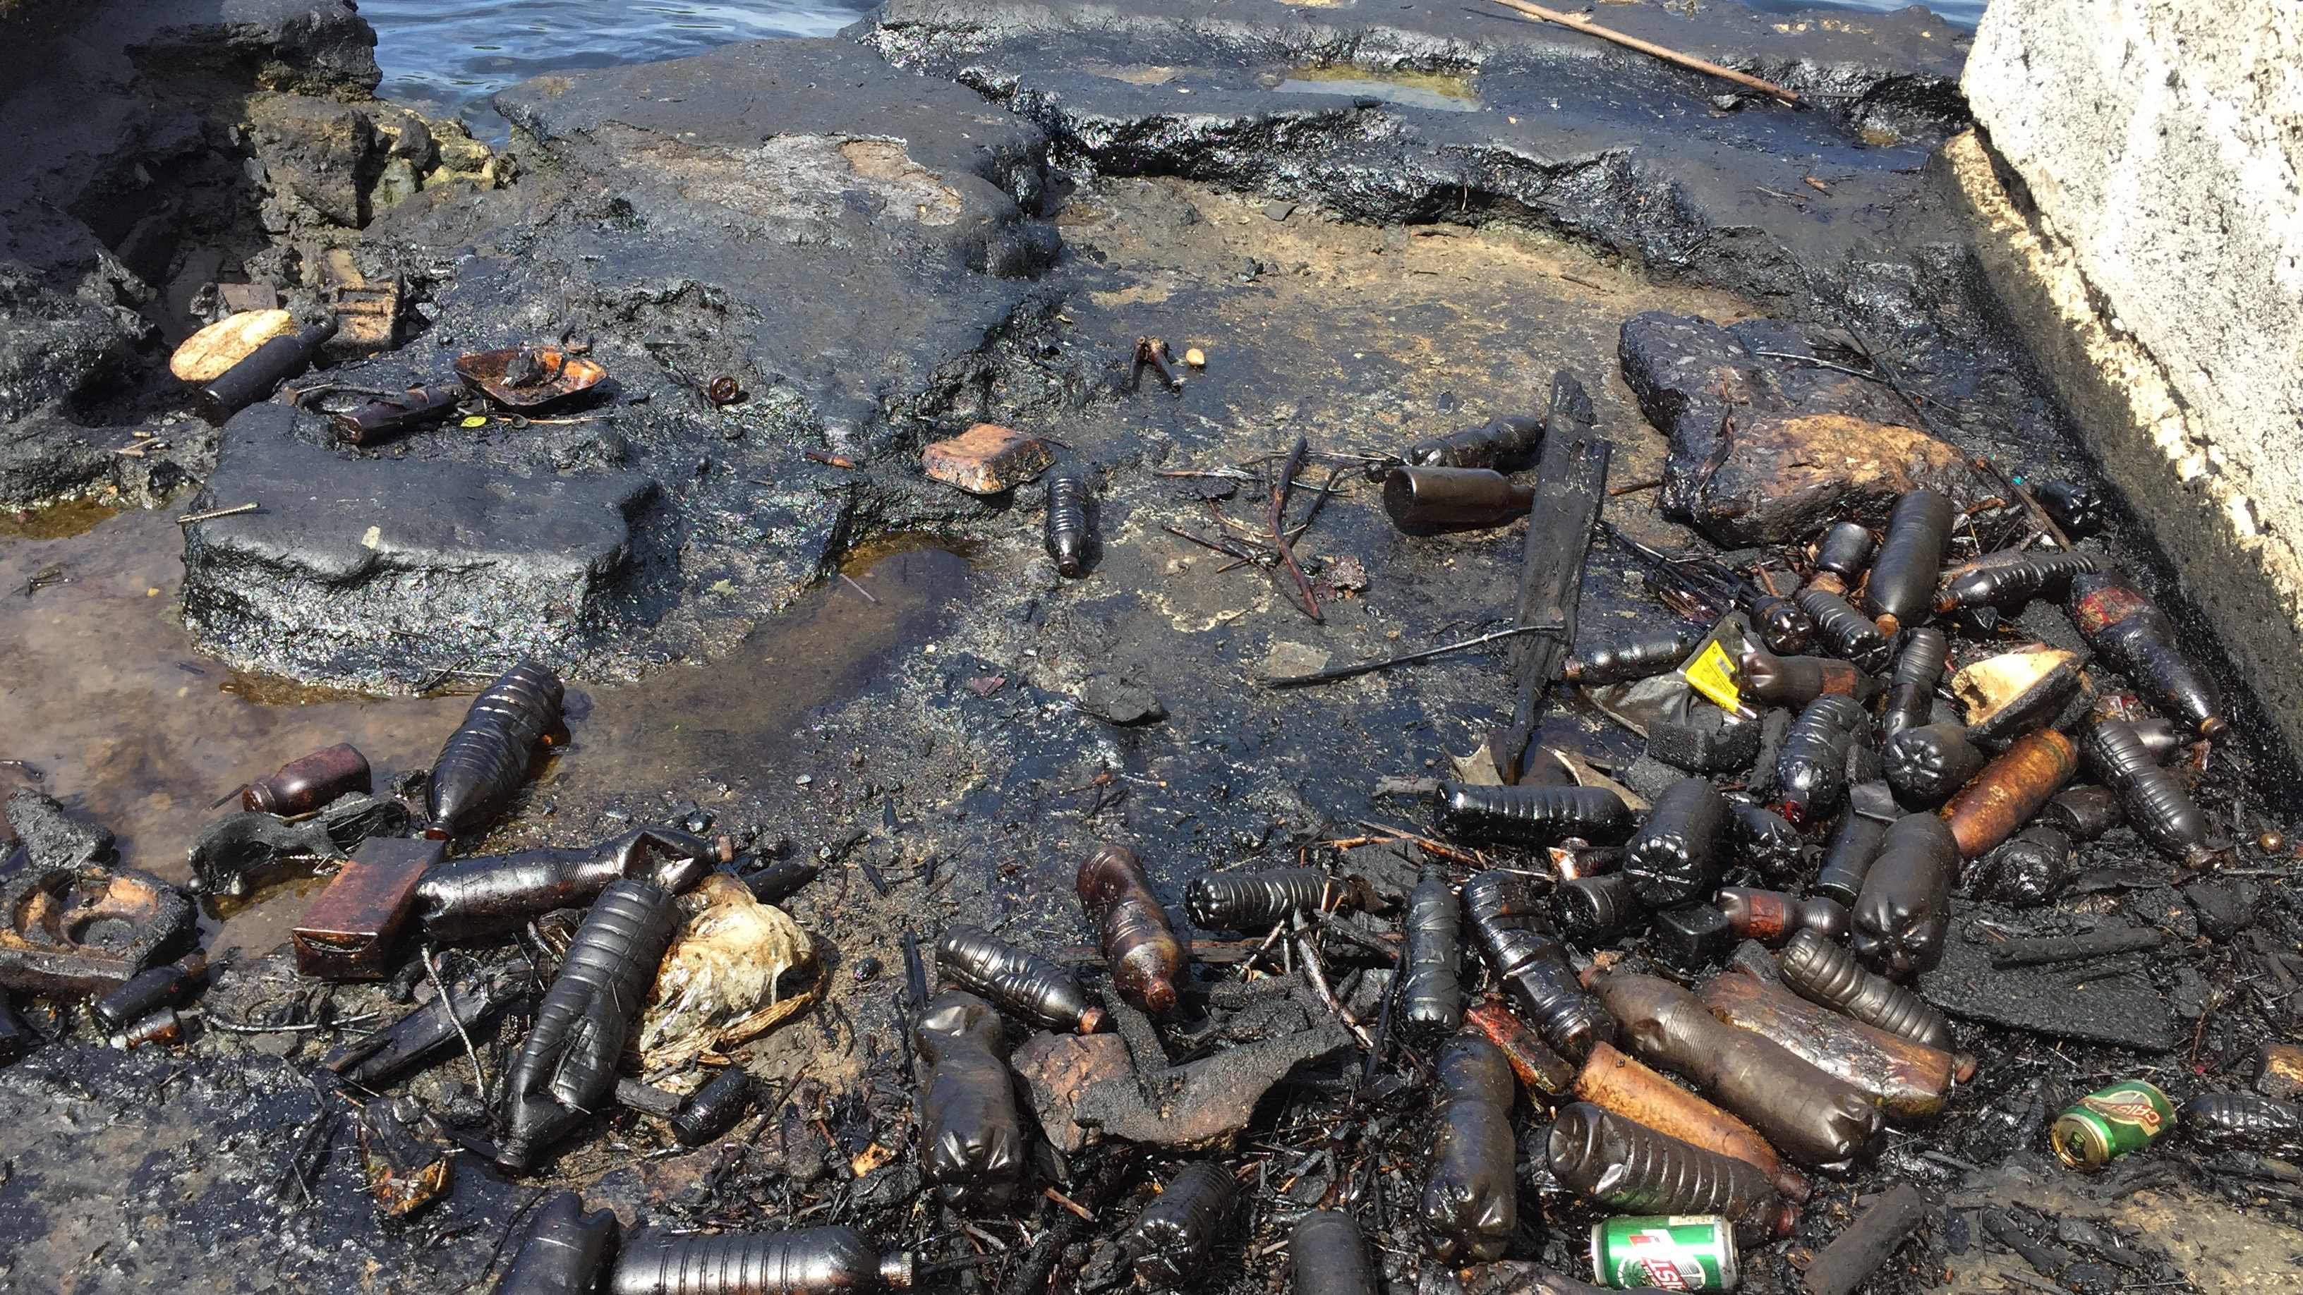
Welcome to the Anthropocene

Slide 8
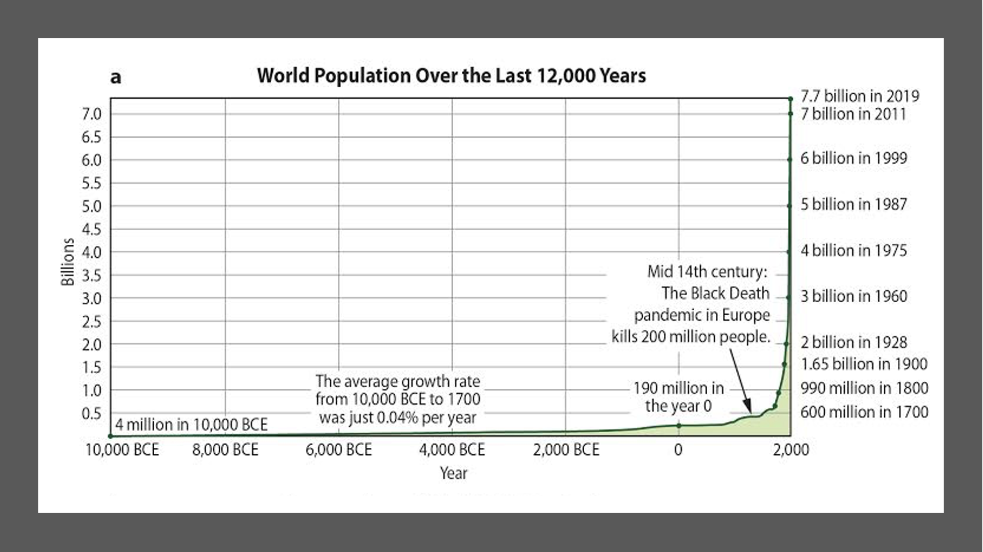

Slide 9
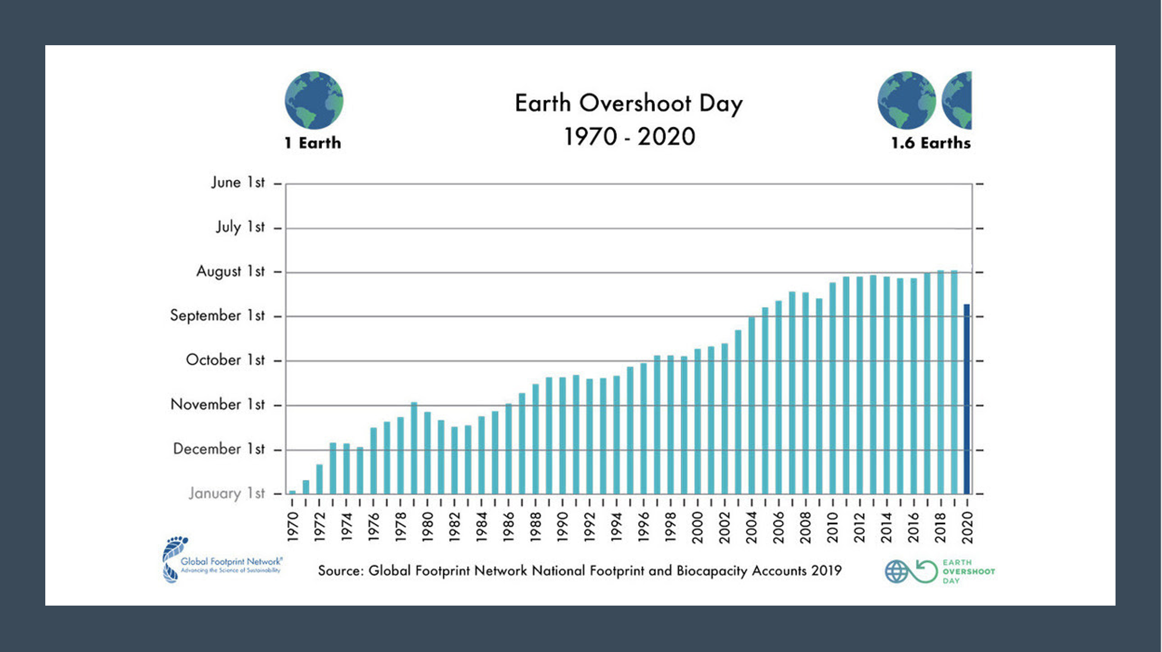

Slide 10
Humans are causing the planet to change…

Slide 12
April 26th 422ppm

Slide 13
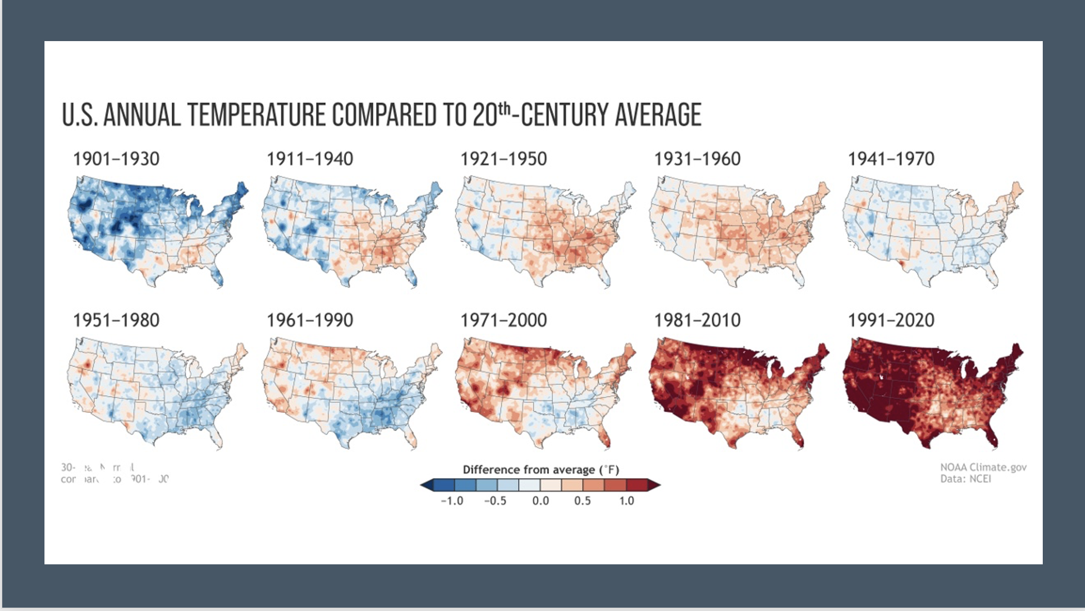

Slide 18
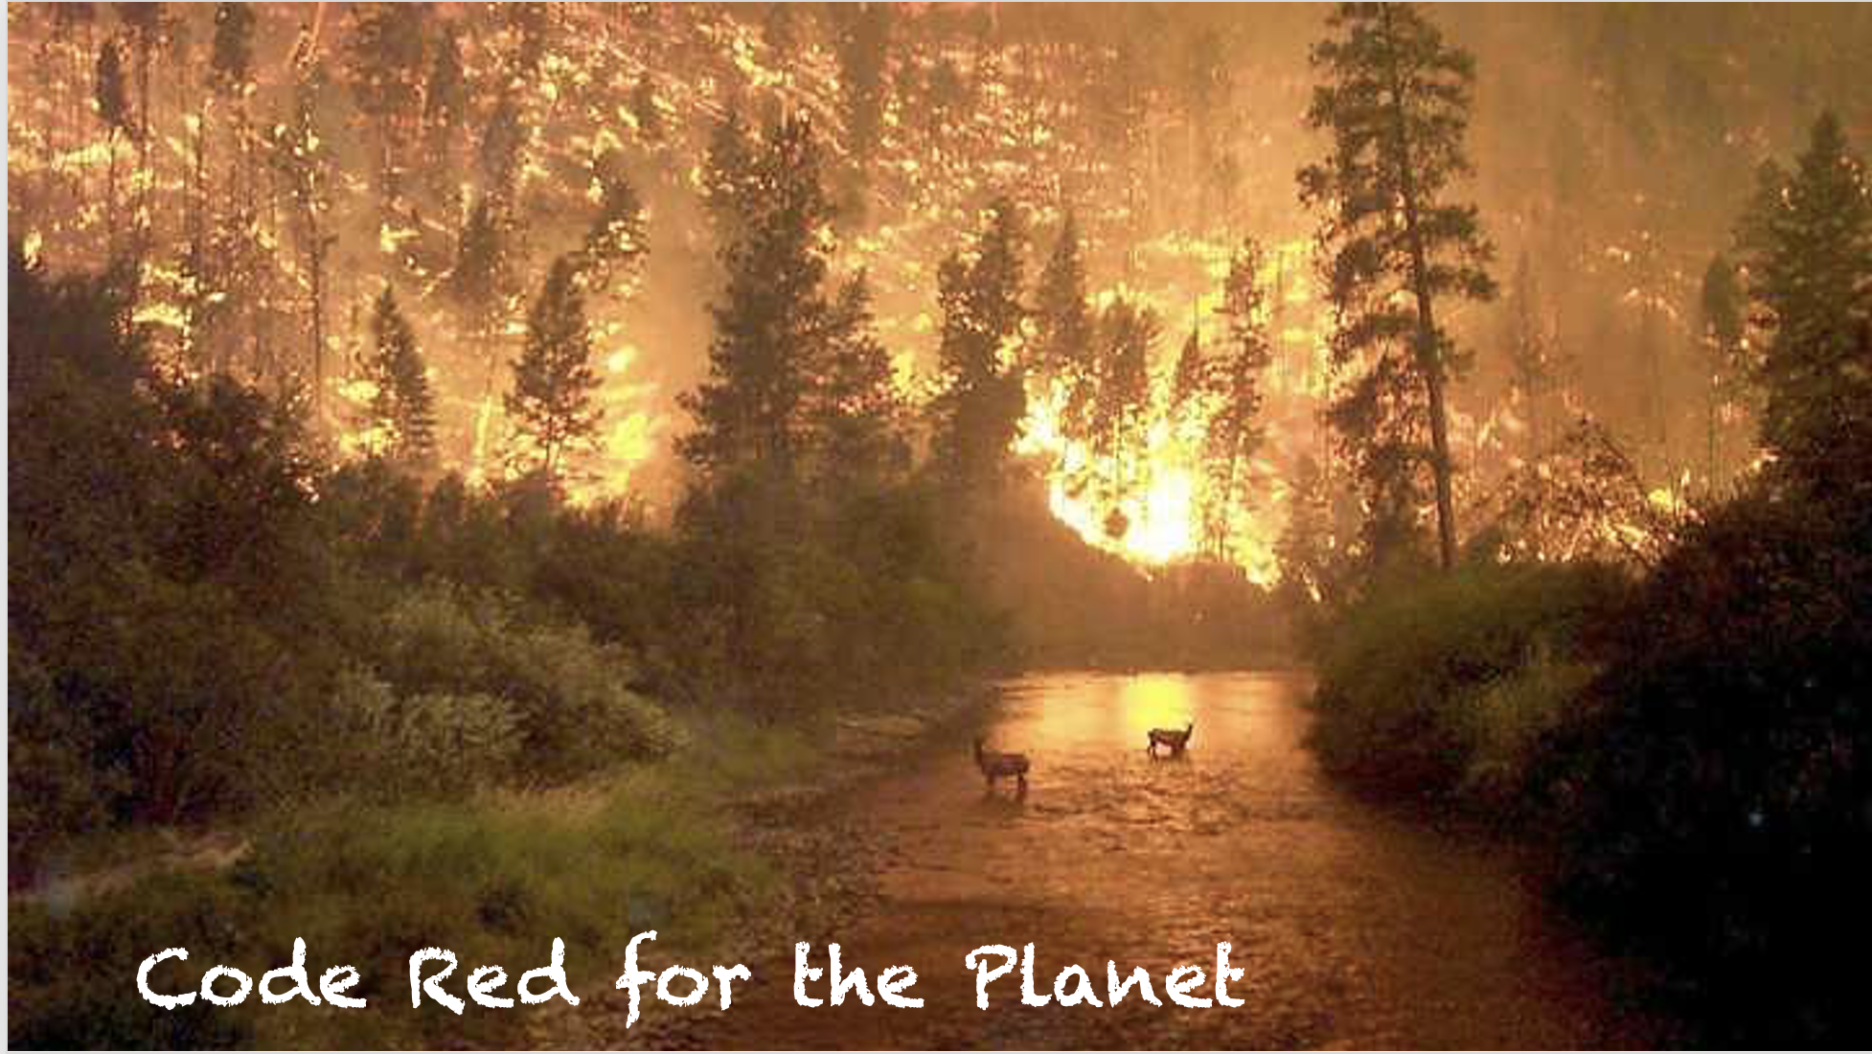

Slide 19
CLIMATE CHANGE AND SOCIAL VULNERABILITY IN THE UNITED STATES Environmental Protection Agency Report (EPA) September 2021 (p.6)
Black and African American individuals are 40% more likely to currently live in areas with the highest projected increases in mortality rates due to climate-driven changes in extreme temperatures.
Black and African American individuals are 34% more likely to live in areas with the highest projected increases in childhood asthma diagnoses due to climate-driven changes in particulate air pollution.
Hispanic and Latino individuals are 43% more likely to currently live in areas with the highest projected labor hour losses in weather-exposed industries

Slide 21
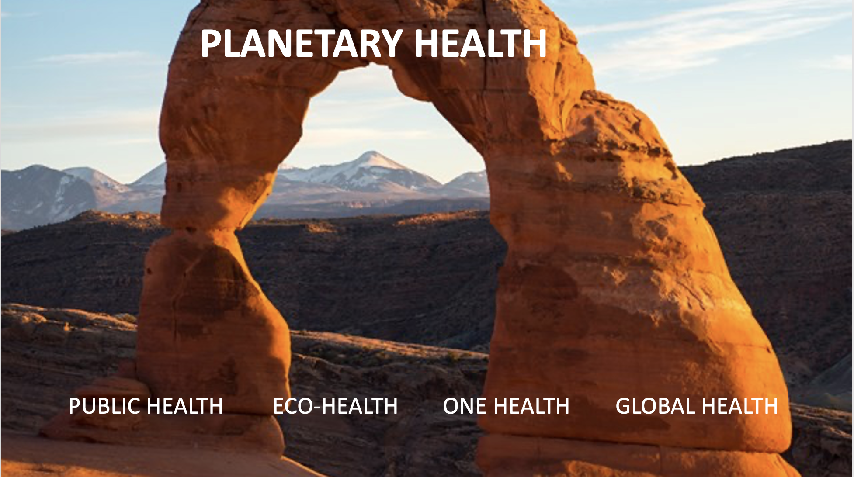
UN SUSTAINABLE DEVELOPMENT GOALS

Slide 22
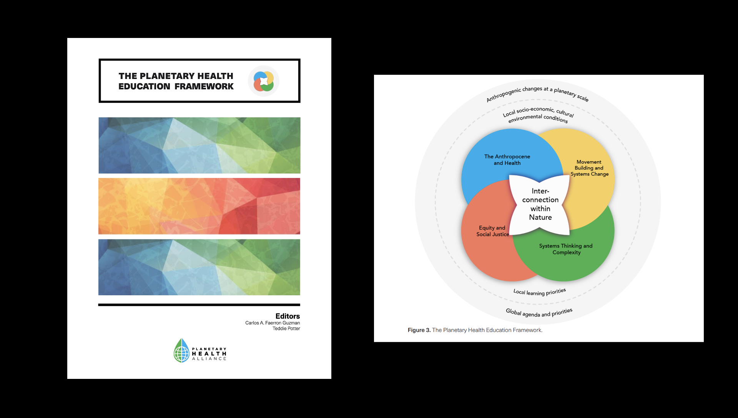

Slide 24
Sao Paulo Declaration for Planetary Health:
Guidance for the Health Sector
Reorient all aspects of health systems toward planetary health-- from procurement, energy sources, health care efficiency, to waste reduction. Commit to achieving a Nature-positive, carbon neutral health care system before 2040, while strengthening health care systems’ resilience to global environmental changes. Disease prevention, health promotion, and health equity must be at the heart of this transition. Incorporate health perspectives and traditions beyond traditional Western methods, including traditional knowledges led by Indigenous Peoples, as well as other integrative health practices. Consider social and ecological determinants of health for both individuals and communities, including public and active transportation; access to health care facilities; green spaces to provide social, recreational, and mental health benefits; air, soil, and water quality; and access to affordable nutritious diets, particularly for lower income communities. Advocate for public access to culturally appropriate health services as a human right. (p. 6)

Slide 25
EVERYTHING must change in 10 years! But it is possible!

Slide 26
Article in press: American Journal of Public Health The Public Health Crisis is Planetary – and Nursing is Crucial to Addressing It Ann Kurth and Teddie Potter

Slide 27
References and Resources
Global Footprint Network. (2020). Earth Overshoot Day 2019 is July 29th, the earliest ever. Retrieved from https://www.overshootday.org/
Muir, J. (1911). My first summer in the Sierra. New York, NY: Houghton Mifflin.
Planetary Health Alliance- https://planetaryhealthalliance.org/
Planetary Health Alliance. (2021). Sao Paulo Declaration on Planetary Health. https://www.planetaryhealthalliance.org/sao-paulo-declaration
Faerron Guzman, C. A., & Potter, T. (Eds.). (2021). Planetary health education framework.
Watts, N., Amann, M., Arnell, N., Ayeb-Karlsson, S., Belesoviva, K., Boykoff, M. et al. (2019). The 2019 report of The Lancet Countdown on health and climate change: ensuring that the health of a child born today is not defined by a changing climate. The Lancet, 394(10211), 1836-1878. DOI:https://doi.org/10.1016/S0140-6736(19)32596-6

