Slide 1
Eliminating Health Disparities through Food Justice
Bois Forte Tribal Government | David Morrison
Dream of Wild Health | Neely Snyder
Hmong American Farmers Association | Janssen Hang
Pillsbury United Communities | Fowzia Abdullahi & Lou Nelson

Slide 2
Eliminating Health Disparities Initiative (EHDI)
Established in 2001 by the Minnesota State Legislature
EHDI invests about $5 million dollars annually in community initiatives
EHDI Grantee projects are grounded in community knowledge and wisdom
Address health inequities for populations of color and American Indians across 8 different priority health areas (PHAs)
Breast and cervical cancer screening, diabetes, heart disease and stroke, HIV/AIDS and sexually-transmitted infections (STIs), immunizations for adults and children, infant mortality, teen pregnancy, unintentional injury and violence
Notes:
Introduce yourself
EHDI was established by the Minnesota State Legislature in 2001 to address the growing health disparities in our state. EHDI invests about $5 million dollars annually in projects run by and for communities of color and American Indians to develop and implement effective community-based strategies. EHDI aims to close the gap in the health status of African Americans/Africans, American Indians, Asian Americans/Asian-Pacific Islanders, and Hispanics/Latinx in Minnesota in eight priority health areas: Breast and Cervical Cancer, Diabetes, Heart Disease and Stroke, HIV/AIDS and Sexually Transmitted Infection (STIs), Immunizations for Children and Adults, Infant Mortality, Teen Pregnancy, and Unintentional Injury and Violence. This can even be shortened to something like: EHDI was established by the Minnesota State Legislature in 2001 to address the growing health disparities in our state. EHDI invests about $5 million dollars annually in organizations and tribes to develop and implement strategies grounded in community strengths. EHDI aims to close the gap in the health status of African Americans/Africans, American Indians, Asian Americans/Asian-Pacific Islanders, and Hispanics/Latinx in Minnesota in eight priority health areas.

Slide 3
Levels of Change and Impact
Level 1
Health Promotion/Direct Service
Level 2
Organizational/Institutional Change
Level 3
Root Causes/Conditions for Health
During the COVID-19 pandemic, EHDI grantees:
Reached more than 650,000 individuals
Maintained 105 clinics in 24 cities across 10 counties
Opened 30+ new sites in 2020-2021
Worked with 120 students and 89 families
Notes:
EHDI works happens across many levels and has had a large collective impact.

Slide 4
Food Justice
1 in 10 Minnesotans experience food insecurity*
BIPOC are at least twice as likely as whites to experience food insecurity in MN*
They suffer the greatest disparities in diet-related chronic diseases caused by lack of access to quality nutrition
Food as medicine
Community supported agriculture
Food sovereignty
Policy & advocacy to support an Indigenous food system
Food autonomy
Collaborative work within communities
Land tenure
Traditional food gathering activities
Notes:
This morning/afternoon my colleagues and I, as EHDI grantees, will share with your how we are advocating for food justice across communities. We represent 4 organizations that are funded under the MN Dept of Health’s Eliminating Health Disparities Initiative grant program, or EHDI for short. Each of us will talk about that component of our EHDI project.

Slide 7
The Indigenous Food Network (IFN)'s mission is to rebuild sovereign food systems within the intertribal Native communities through collaboration.
The work of the IFN builds on the cultural knowledge of community members and uses an intertribal and multigenerationaI approach.

Slide 8
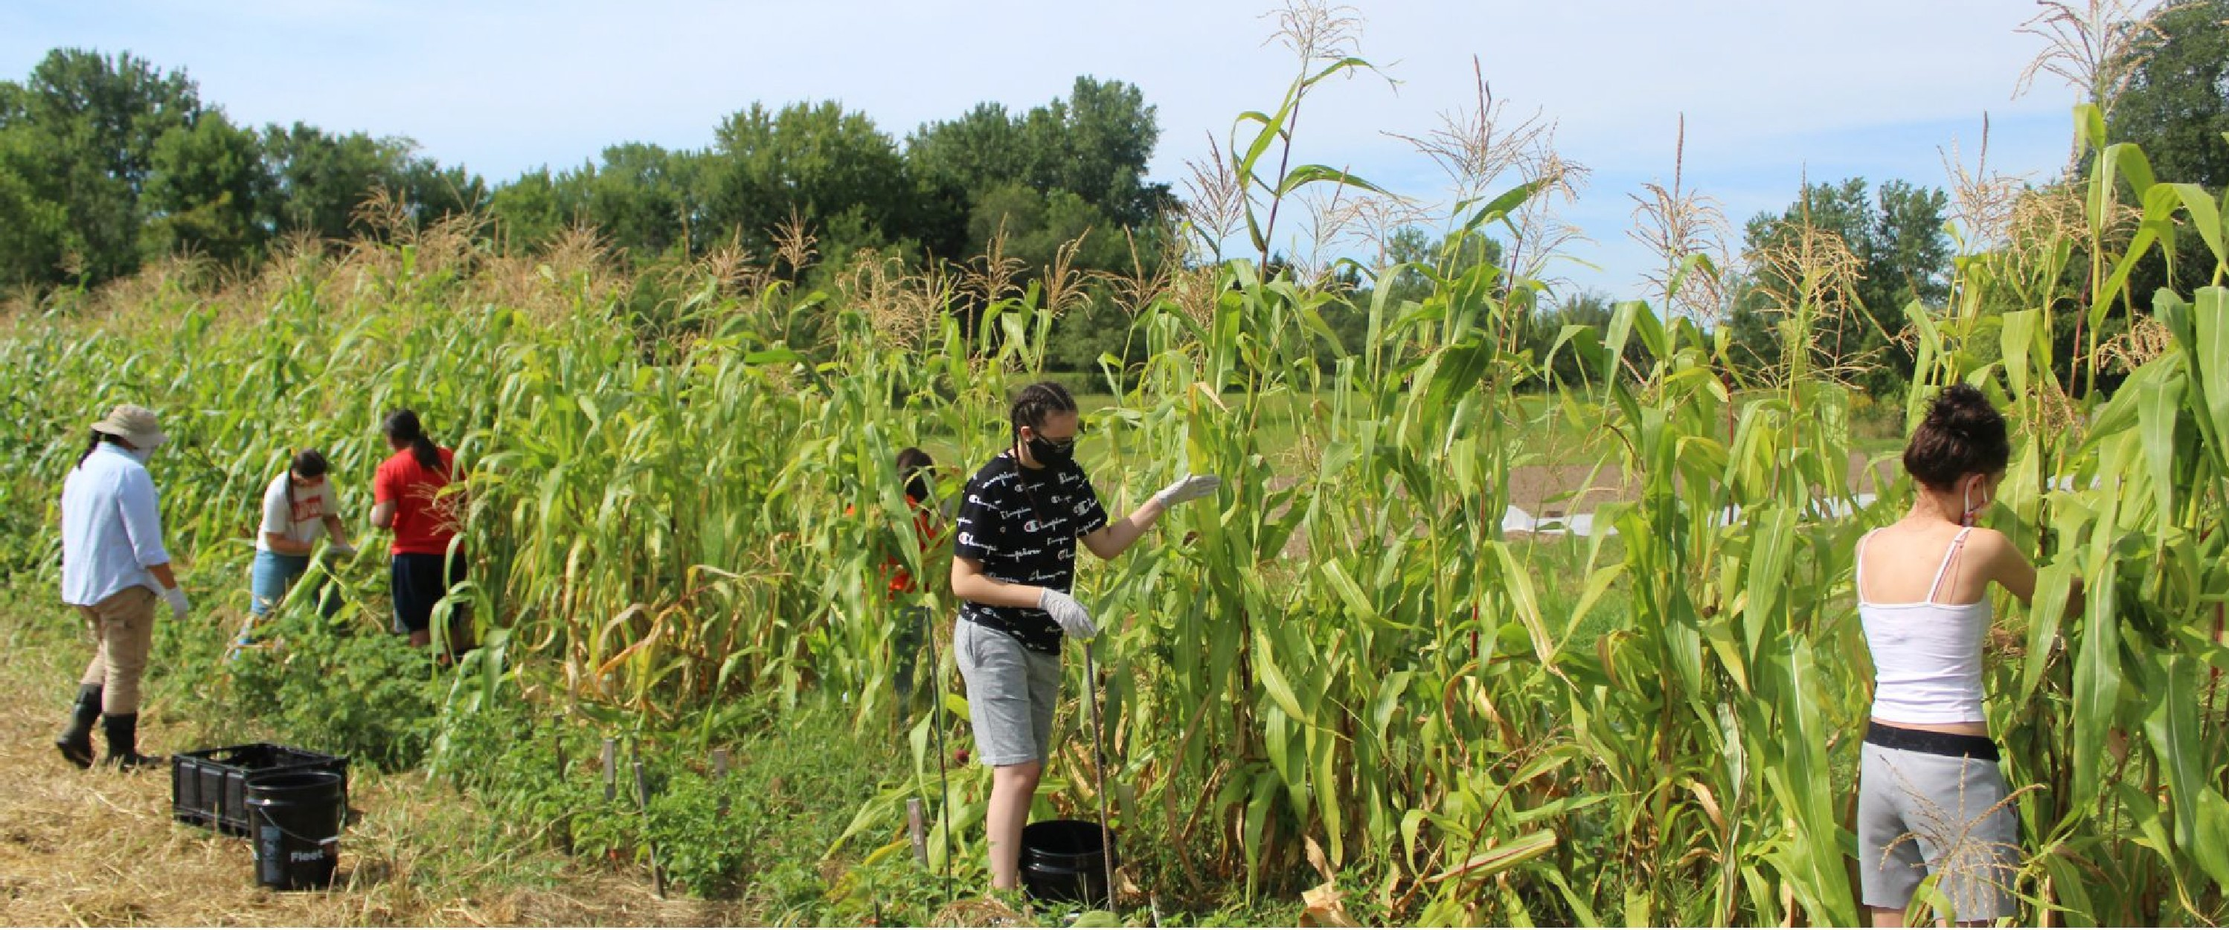
THE FARM
The farm is a safe place for children. It is a place where we cherish and protect the seeds as our ancestors. It is a place where we keep our values alive.

Slide 10
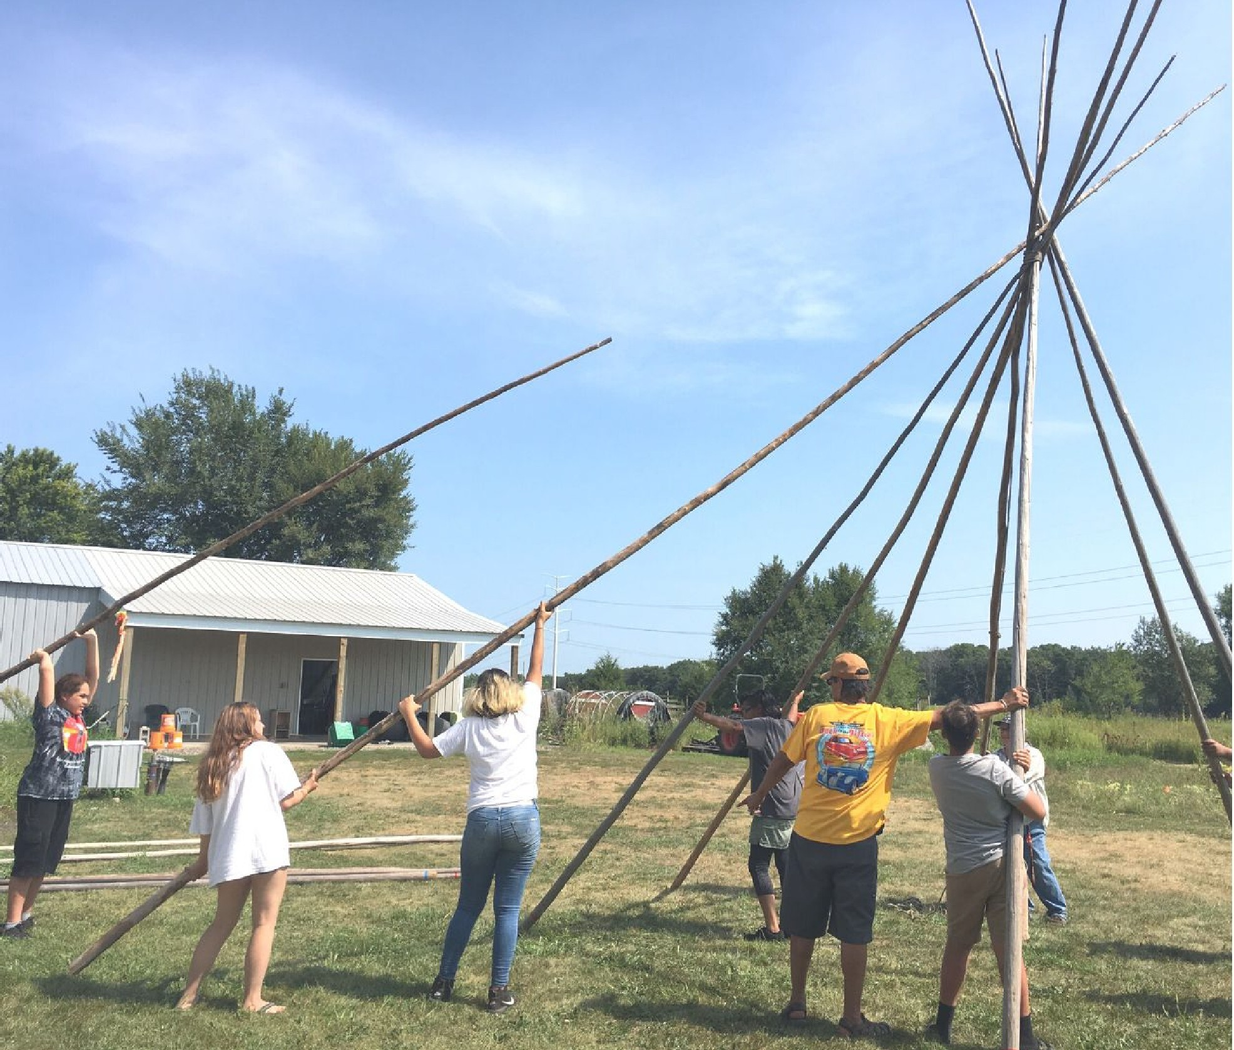
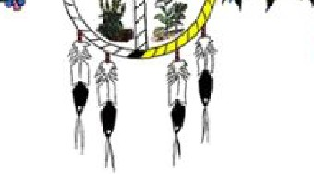
Dream
at WiId' 'Health
.:,.»:>-..-.■.-1
Connect with us!
@dreamofwildhealth
1 @dreamofwildhealth
rl
11^{Y}'!º1^{u}!1
Im
@dreamwildhealth
/c/dreamofwildhealth
@dreamofwildhealth
www.dreamofwildhealth.org

Slide 11
Food + Community Health
Fowzia Abdullahi & Lou Nelson
Pillsbury United Communities Community Health Team

Slide 12
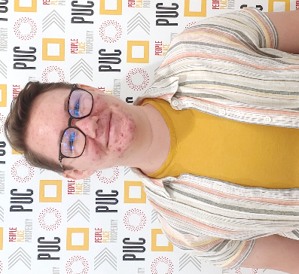
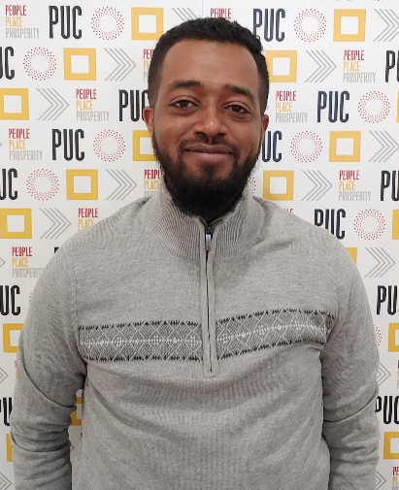
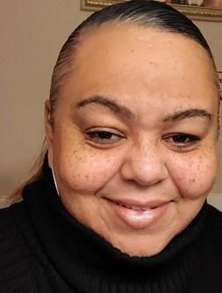
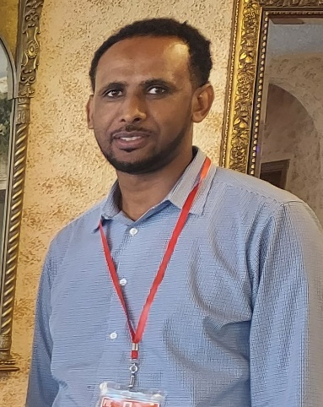
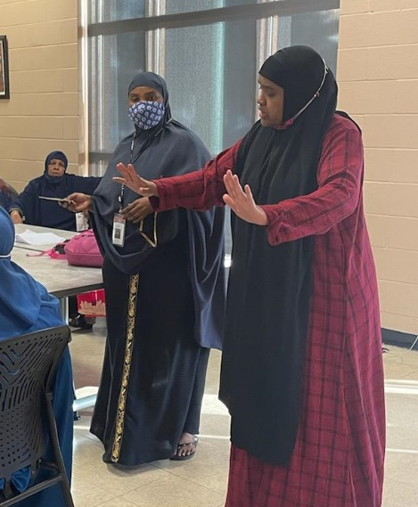
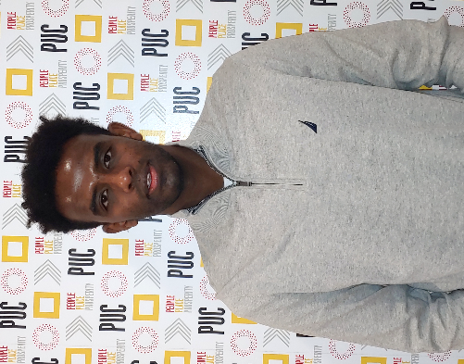
Who we are
Community Health
Community Health Workers
Social Service Support
Eliminating Health Disparities
Food Systems
Urban Agriculture
Food Shelves
Youth Education

Slide 13
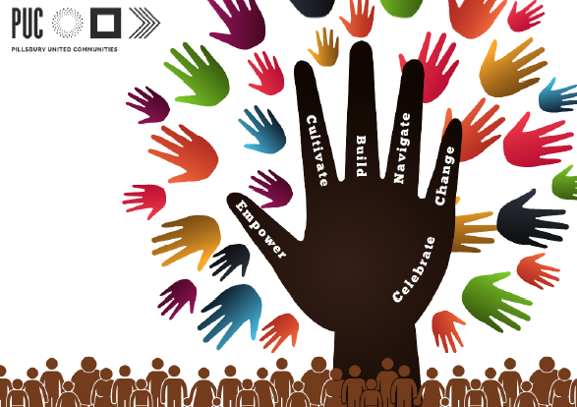
Our approach: Eliminating health disparities
We are who we serve
Knowledge, Skills, Confidence
Exercise
Healthy eating practices
Medication management
Communicating with healthcare providers
Connection to social and health services (SSI, SNAP, etc.)
Fresh and healthy food access
Notes:
EMPOWER healing
CULTIVATE spaces for connectedness and belonging
BUILD capacity and leadership
NAVIGATE past barriers
CHANGE policy and systems
CELEBRATE individuals and community

Slide 14
Program highlight: CDSMP+
Chronic Disease Self-Management Program (Living Well with Chronic Conditions) in partnership with Trellis
6-week workshop for seniors: 6 workshops/year
Food topics covered:
Reading labels & nutrition facts
serving proportions
Discussing different types of food (proteins, carbohydrates, fruits and vegetables). Encouragement to eat more produce.
And we don’t stop there!
Notes:
Pre/post surveys: ALL those who finished the course either agreed or strongly agreed that it helped them to eat healthy.

Slide 15
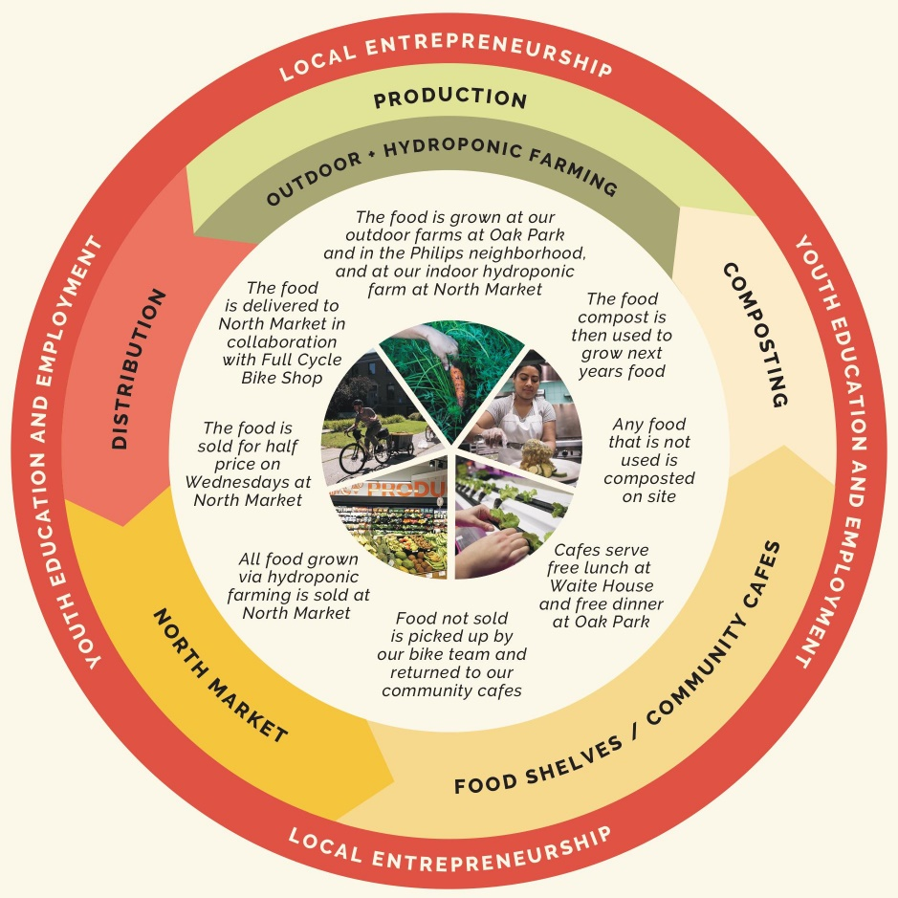
Food systems
Food shelves
Over 360,000 pounds of food given out in 2021 to over 800 families
Urban Agriculture
Brian Coyle Community Garden
Produce Giveaways
Nearly 200,000 pounds given out in 2021
Typical food shelves with canned-only food can exacerbate conditions like diabetes and cardiovascular disease. Our integrated food systems make it easier for people to eat healthy.
Policy Work
Notes:
We work closely with PUC’s Food Systems team, which works on all levels of food systems in Minneapolis. Here are a few of the ways that team is involved in food justice work at Brian Coyle.
Food shelves provide access to basic food items – both non-perishable and produce.
The Coyle Garden supplies fresh produce on-site – over 800 pounds of produce was grown and distributed directly from our center in 2021.
We also collaborate with other partners like local farms and distributors to bring more produce to our communities. (read from “typical food shelves”).
Finally, we are working on a policy level to ensure that farming, fresh food, and community gardens are accessible to the communities we serve. Leadership are on several coalitions across Minneapolis (including helping to found the Metro Food Justice Network) to ensure that happens. And it’s our on-the-ground work in communities that give us insight into what is needed on that policy level.

Slide 16
Culturally-specific, Healthy food
“Food is medicine, and our communities WANT to eat healthy, but often times don't have access to the healthy food they want and deserve. That is why our work is so important. We want to make sure everyone who wants to eat healthy, has the ability.”
Ethan Neal, Director of Food Systems
“It’s about the culture, about how people feel – Brian Coyle food shelf is there for them when another big or small store doesn’t have that thing [culturally-specific food] for them.”
Awol Windissa, Director of Community Health
Notes:
We want to highlight two things here: first, people want to eat good and healthy food. Our work is to help make sure that can happen. Second, having access to and eating food that makes sense for the cultural communities we serve is as important as having access in the first place. Research we participated in with the Wilder Foundation in 2018 showed that while many families felt that culturally-relevant food (like rice, goat meat, dates, etc.) was too expensive or hard to find in other places, they were able to find it at our food shelves. In that way, our food shelves are part of a food system that keeps people connected to their cultural and religious roots and practices.

Slide 17
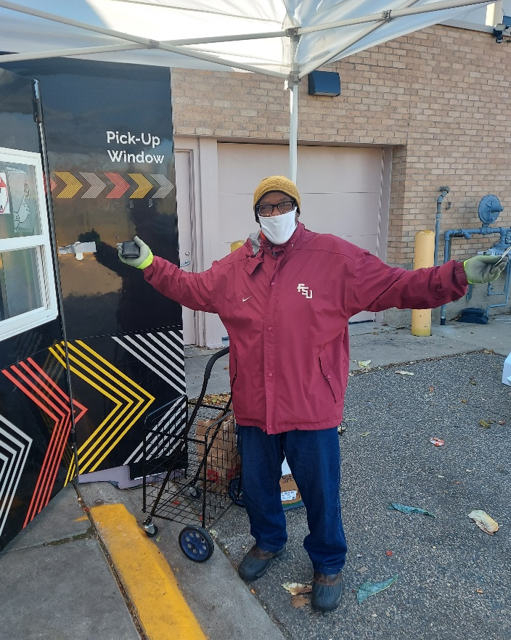
To recap
We provide
access to local food and fresh produce
knowledge and confidence to buy and cook healthy food
resources like help navigating SNAP and SSI applications and renewals
An environment that supports urban agriculture – policy level
Notes:
To recap, our work for justice in food systems involves access to fresh food, but it doesn’t stop there. We are also working to help community members develop knowledge, skills, and confidence to eat healthy in ways that work for them. We’re helping them get to and stay in financial situations that keep them healthy by supporting them in processes like SNAP and SSI applications and renewals. And we’re also staying involved on a policy level to ensure that the resources our communities want and need are available and expanding.
Thank you for your time.

Slide 18
David Morrison Jr: is a member of the Bois Forte Band of Chippewa, located in Nett Lake, MN, and lifelong resident. David is currently the Fitness Coordinator and manages several grants such as the Eliminating Health Disparities Initiative (EHDI) and Saving Lives Project Grants. David’s role is to provide activities for his community, which include elders exercise, fitness classes, health education conferences, walks, 5K runs, canoe lessons, teaching youth how to gather & process wild rice, how to safely net walleye with both given to the Elder Feeding Program that they use throughout the year, community sporting events, youth sports (basketball/baseball).
Zhaskubinasee/Niigahbiwee who belongs the Name Dodame, is also active in his Native American Heritage as a drum keeper, which is to provide the drum when requested by community members for healing ceremonies, funerals, honoring people, social events, school events and pow wows.
When not busy with work, he enjoys playing softball, golfing with friends, playing pool, spending time with his family, listening to music and travelling to pow wows.

Slide 19
Absabiikone-zaaga’igan (Nett Lake)
The vision/dream/prophecy of our Anishinaabe (Original People), the Manidoo (Spirit) was telling them to keep going In’gaabeanong (west) until they come upon a place where it is filled with food. So, when they come onto the mouth of the lake from a river (Lost River), they saw fields of what they thought was long grass, when they paddled into it, they realized it was Manomin (Wild Rice), the Manidoo kept telling them to keep coming and that’s when they saw the Manidoo wearing a net top at the Island now known as Spirit Island. The net the Manidoo had on, and the lake filled with Manomin, is how Nett Lake got its name became known for our Manomin and ducks.

Slide 20
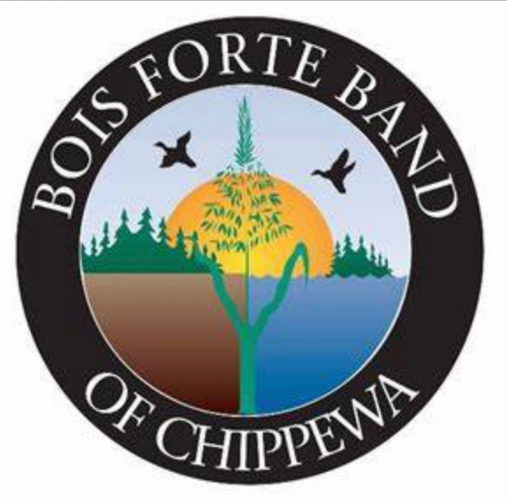
Bois Forte Band of Chippewa
Our Bois Forte logo represents our wild rice, ducks, land and lake.

Slide 21
Manominike-Giizis (Rice Harvest Moon)
Manomin (wild rice) has played a significant role in survival of the Ojibwe. Manomin is a water grown grain found throughout North America. In Nett Lake before the wild rice harvest begins, there is a first pick ceremony. It is accustomed before going onto the lake, that the Anishinaabe offer Asemaa (Tobacco) to be placed in the lake for the harvest and the safety of people while gathering wild rice. Manomin is harvested from a canoe. The long stalks of the rice are bent over the canoe and are knocked in with knocking sticks.
After getting back onto the landings, from a day’s picking, they sack up the rice, it is then spread out on tarps for drying, this quickens the parching process. The rice is parched by slowly stirring and turning the rice so it can cook in pans and/or kettles over an open fire. Parching allows the hulls of the grain to loosen and will come off more easily. The kettle holds about 12-15 pounds of rice and typically takes 20-25 minutes per batch. Pan parching holds about 70-80 pounds of rice and will take 60-70 minutes to parch. A rule of thumb from green rice to finished rice, usually finishes out to be about 50%, so 500 pounds of rice from the lake to drying, parching and threshing will typically end up as 250 pounds finished. As the rice ripens the percentage goes up.
Modern day Threshing Machine is (powered by truck) needs at least 50 pounds of rice to run through the machine, where rubber knobs take off the hulls and the Mazaan (rice dust) is then vacuumed out of the Manomin. Jigging (Traditional Style) 15 pounds of rice is placed in a barrel and is danced upon by a smaller person in a twisting motion to loosen up the hulls and then is Winnowed (Fanned) this requires the rice to be placed in a birch bark basket and gently tossed into the air, in which the hulls and Mazaan is blown out by the wind or fan for a clean finish.
Mii Gwech Manomin (Thank you wild rice) is celebrated after the Manomin harvest season with a Pow Wow where we give the visitors rice, we also have a community feast, offer food and tobacco to the spirits. This is the Anishinaabe way to say thanks (Miigs) to the Spirits for allowing us to have a harvesting season.

Slide 22
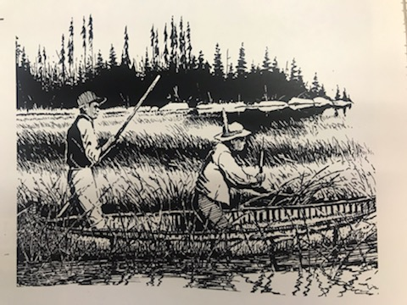

Slide 23
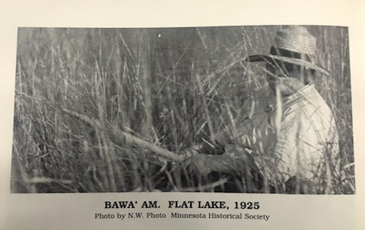

Slide 24
Our Mission for the youth
Is to instill our traditions with the Nett Lake Elementary School & our Middle/High School Students, by providing knowledge on how to harvest and gather wild rice, creating a rice camp during school for them to have a chance to participate in these practices, also by taking small steps with canoe lessons before the rice harvest season so they feel comfortable being in a canoe, they are also taught to give back to our elders for the elders meal feeding program so they have rice throughout the year from the finished rice, we also teach offering thanks to the manidoo for our rice harvest season and have a community feast.

Slide 26
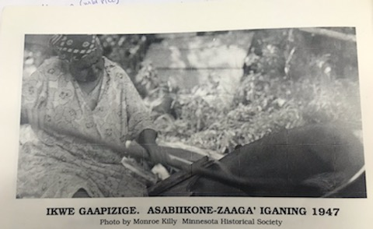

Slide 27
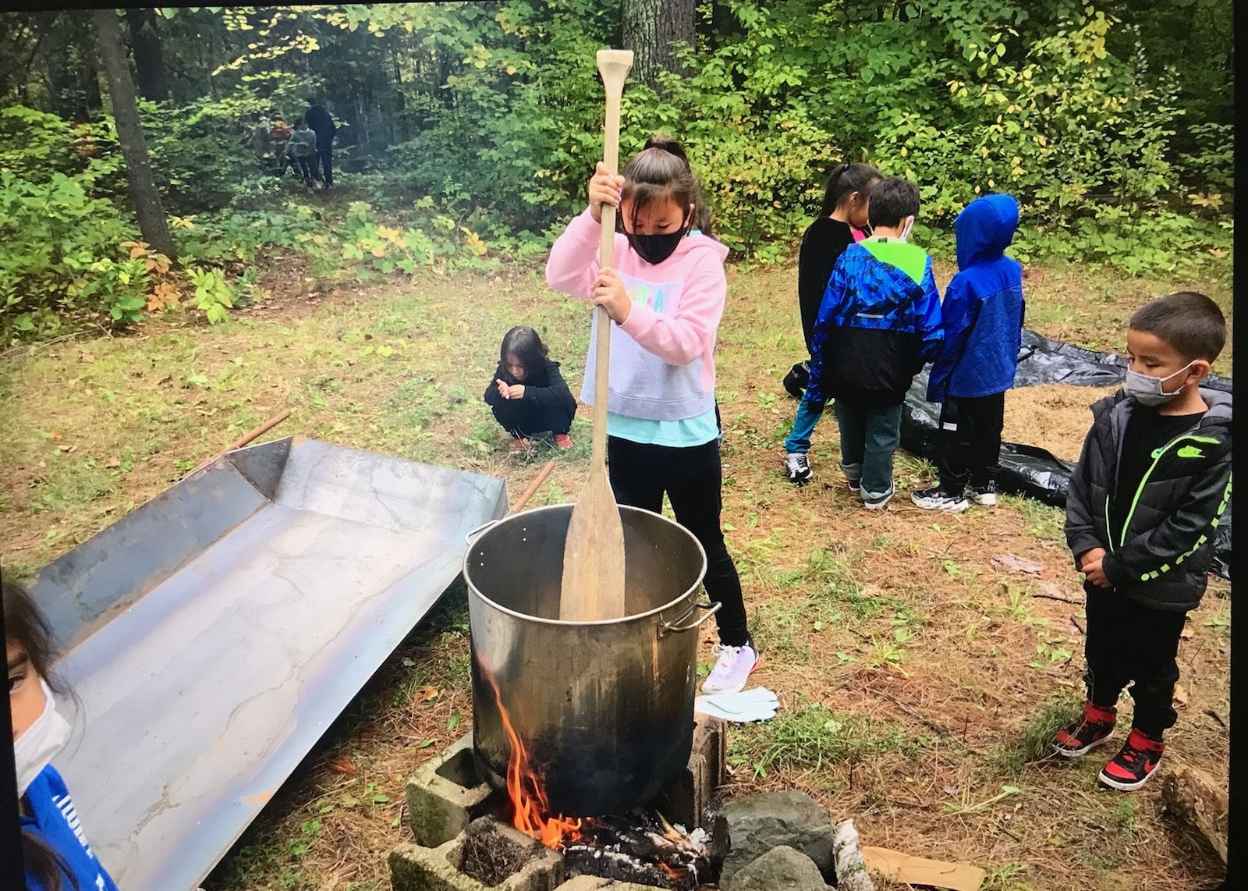

Slide 28
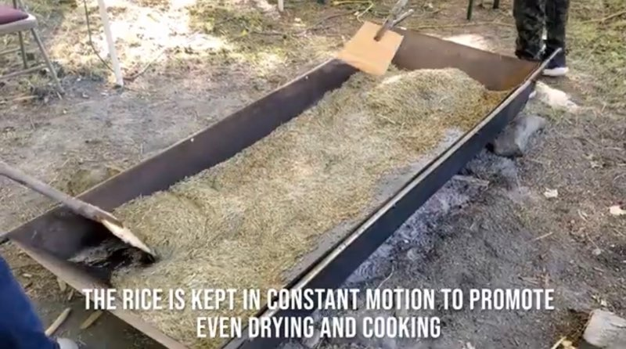

Slide 29
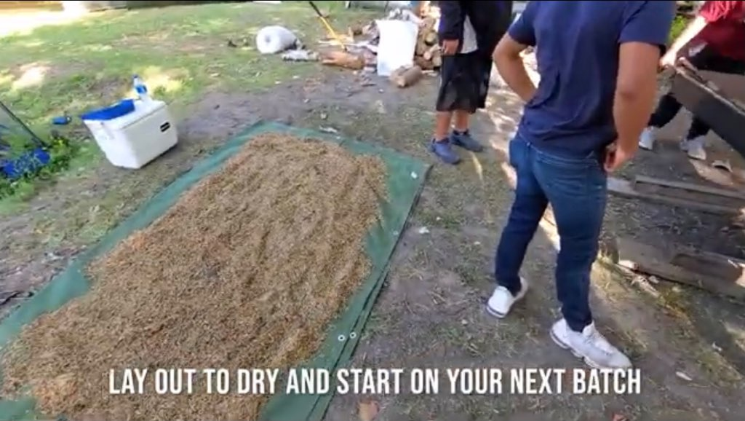

Slide 30
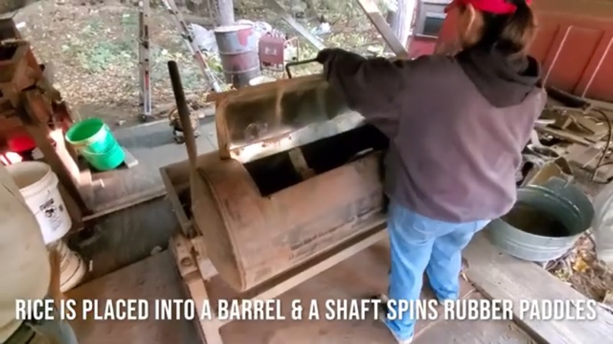

Slide 31
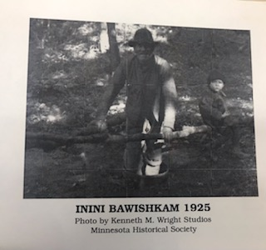

Slide 32
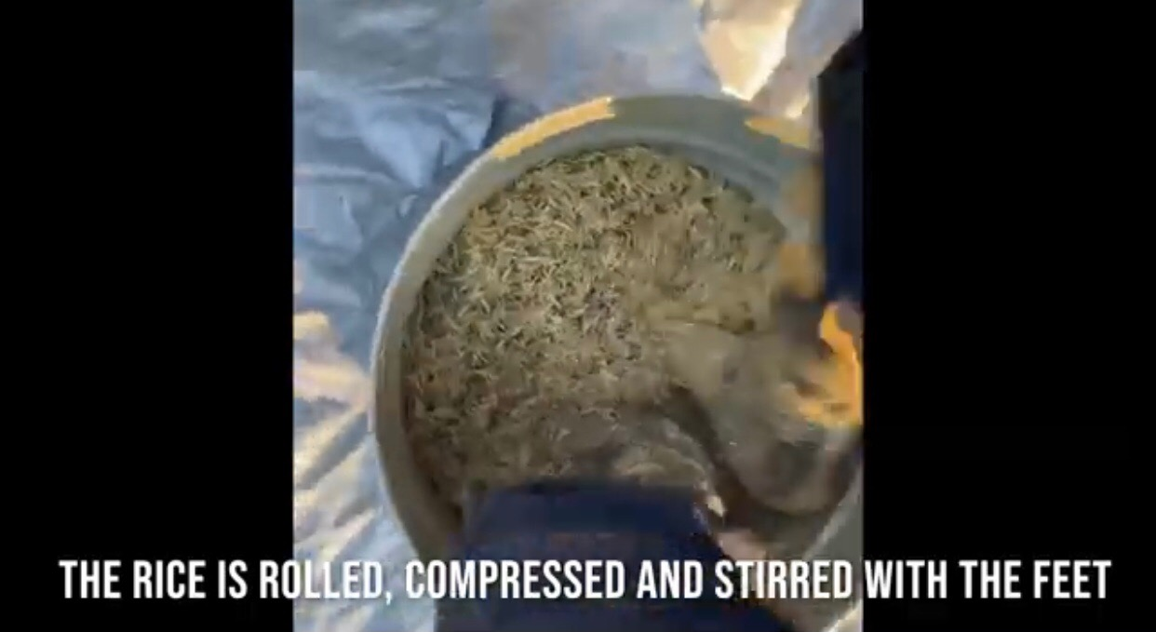

Slide 33
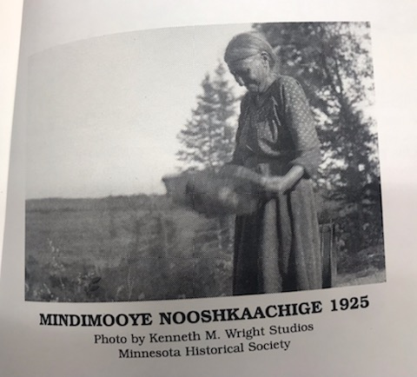

Slide 34
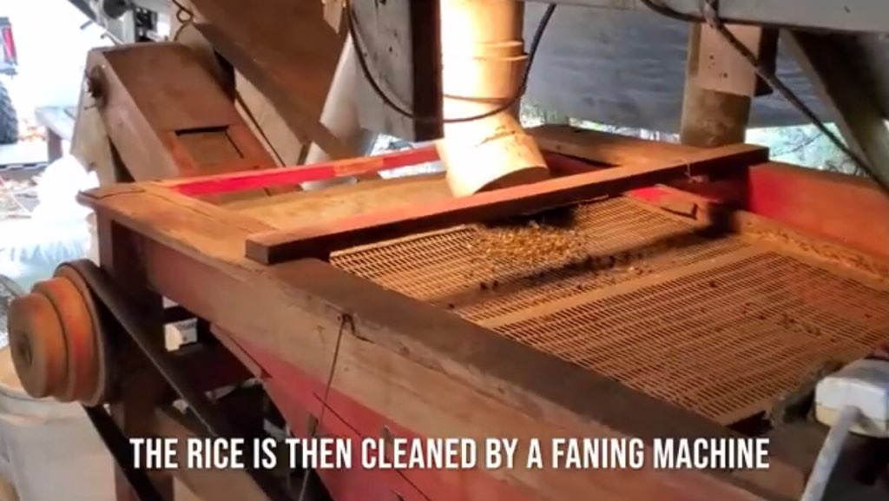

Slide 35
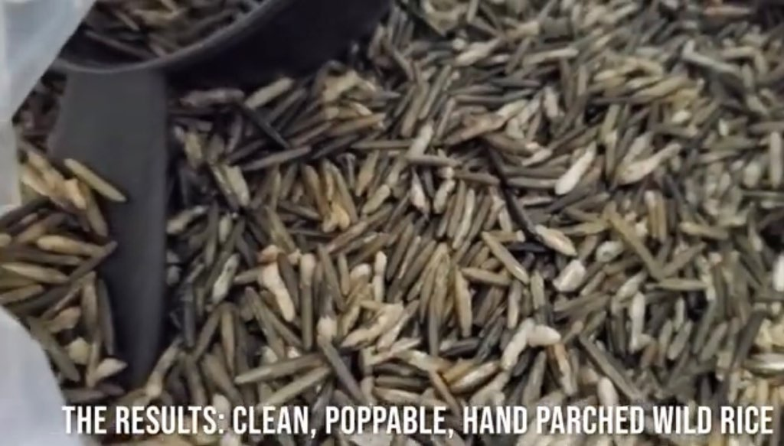

Slide 36
About Nett Lake & Ricing
3 sectors of Bois Forte Reservation- Nett Lake (350 residents)
Vermilion (400 residents) 60 miles east of Nett Lake.
Deer creek (No residents) 40 miles southwest of Nett Lake.
Wild rice is a main source of food for our Bois Forte Band Members throughout the year.
Rice provides a means of income.
Brings families & people together.
Quality of rice provides a market overseas.
No motorboats allowed on Nett Lake.
Remote location 60 miles to closest food source.
Food desert.
4 items needed to go ricing: Canoe, paddles, push pole, knocking sticks.
Offering tobacco.

Slide 37
Hmong American Farmers Association
Janssen Hang
Notes:
Introduce yourself
EHDI was established by the Minnesota State Legislature in 2001 to address the growing health disparities in our state. EHDI invests about $5 million dollars annually in projects run by and for communities of color and American Indians to develop and implement effective community-based strategies. EHDI aims to close the gap in the health status of African Americans/Africans, American Indians, Asian Americans/Asian-Pacific Islanders, and Hispanics/Latinx in Minnesota in eight priority health areas: Breast and Cervical Cancer, Diabetes, Heart Disease and Stroke, HIV/AIDS and Sexually Transmitted Infection (STIs), Immunizations for Children and Adults, Infant Mortality, Teen Pregnancy, and Unintentional Injury and Violence. This can even be shortened to something like: EHDI was established by the Minnesota State Legislature in 2001 to address the growing health disparities in our state. EHDI invests about $5 million dollars annually in organizations and tribes to develop and implement strategies grounded in community strengths. EHDI aims to close the gap in the health status of African Americans/Africans, American Indians, Asian Americans/Asian-Pacific Islanders, and Hispanics/Latinx in Minnesota in eight priority health areas.

Slide 38
Questions
Bois Forte Tribal Government | David Morrison (dmorrison@boisforte-nsn.gov)
Dream of Wild Health | Neely Snyder (neely@dreamofwildhealth.org)
Hmong American Farmers Association | Janssen Hang (Janssen@hmongfarmers.com)
Pillsbury United Communities | Fowzia Abdullahi (FowziaA@pillsburyunited.org) & Lou Nelson (LouN@pillsburyunited.org)

