Slide 1
Creating environments where youth can thrive: Youth Advocacy, Activism, and Leadership in Addressing Social Determinants of Health
Centro Tyrone Guzman | Natty Hels
EMERGE | Will Wallace
High School for Recording Arts | Juan Jackson
Minnesota Community Care | Sandy Naughton

Slide 2
Eliminating Health Disparities Initiative (EHDI)
Established in 2001 by the Minnesota State Legislature
EHDI invests about $5 million dollars annually in community initiatives
EHDI Grantee projects are grounded in community knowledge and wisdom
Address health inequities for populations of color and American Indians across 8 different priority health areas (PHAs)
Breast and cervical cancer screening, diabetes, heart disease and stroke, HIV/AIDS and sexually-transmitted infections (STIs), immunizations for adults and children, infant mortality, teen pregnancy, unintentional injury and violence
Notes:
Introduce yourself
EHDI was established by the Minnesota State Legislature in 2001 to address the growing health disparities in our state. EHDI invests about $5 million dollars annually in projects run by and for communities of color and American Indians to develop and implement effective community-based strategies. EHDI aims to close the gap in the health status of African Americans/Africans, American Indians, Asian Americans/Asian-Pacific Islanders, and Hispanics/Latinx in Minnesota in eight priority health areas: Breast and Cervical Cancer, Diabetes, Heart Disease and Stroke, HIV/AIDS and Sexually Transmitted Infection (STIs), Immunizations for Children and Adults, Infant Mortality, Teen Pregnancy, and Unintentional Injury and Violence. This can even be shortened to something like: EHDI was established by the Minnesota State Legislature in 2001 to address the growing health disparities in our state. EHDI invests about $5 million dollars annually in organizations and tribes to develop and implement strategies grounded in community strengths. EHDI aims to close the gap in the health status of African Americans/Africans, American Indians, Asian Americans/Asian-Pacific Islanders, and Hispanics/Latinx in Minnesota in eight priority health areas.

Slide 3
Levels of Change and Impact
Level 1
Health Promotion/Direct Service
Level 2
Organizational/Institutional Change
Level 3
Root Causes/Conditions for Health
During the COVID-19 pandemic, EHDI grantees:
Reached more than 650,000 individuals
Maintained 105 clinics in 24 cities across 10 counties
Opened 30+ new sites in 2020-2021
Worked with 120 students and 89 families
Notes:
EHDI works happens across many levels and has had a large collective impact.

Slide 4
Youth Advocacy, Activism, and Leadership
Youth care about violence, sexual health, the environment, other inequities, among many
Given the opportunity, youth can make positive changes
Address social determinants of health through leadership roles
Community-based initiatives
Manos Montessori
Youth leadership capacities
Food Shelf Project
SIHLE
Tackle power structures
Youth POWER
Notes:
This morning/afternoon my colleagues and I, as EHDI grantees, will share with your how we are helping build youth leadership capacity to address social determinants of health affecting communities. We represent 4 organizations that are funded under the MN Dept of Health’s Eliminating Health Disparities Initiative grant program, or EHDI for short. Each of us will talk about that component of our EHDI project.

Slide 5
CENTRO TYRONE GUZMAN – SINCE 1974
OUR MISSION:
Centro Tyrone Guzman is committed to the well-being of Latine* families through providing a holistic and intergenerational approach to education, health, and wellness.
OUR VISION:
Centro Tyrone Guzman envisions a vibrant, diverse and inclusive Latine community that belongs and contributes to the social and economic vitality of Minnesota.
OUR VALUES:
Inclusion
Respect
Social Change
Collaboration
Integrity

Slide 6
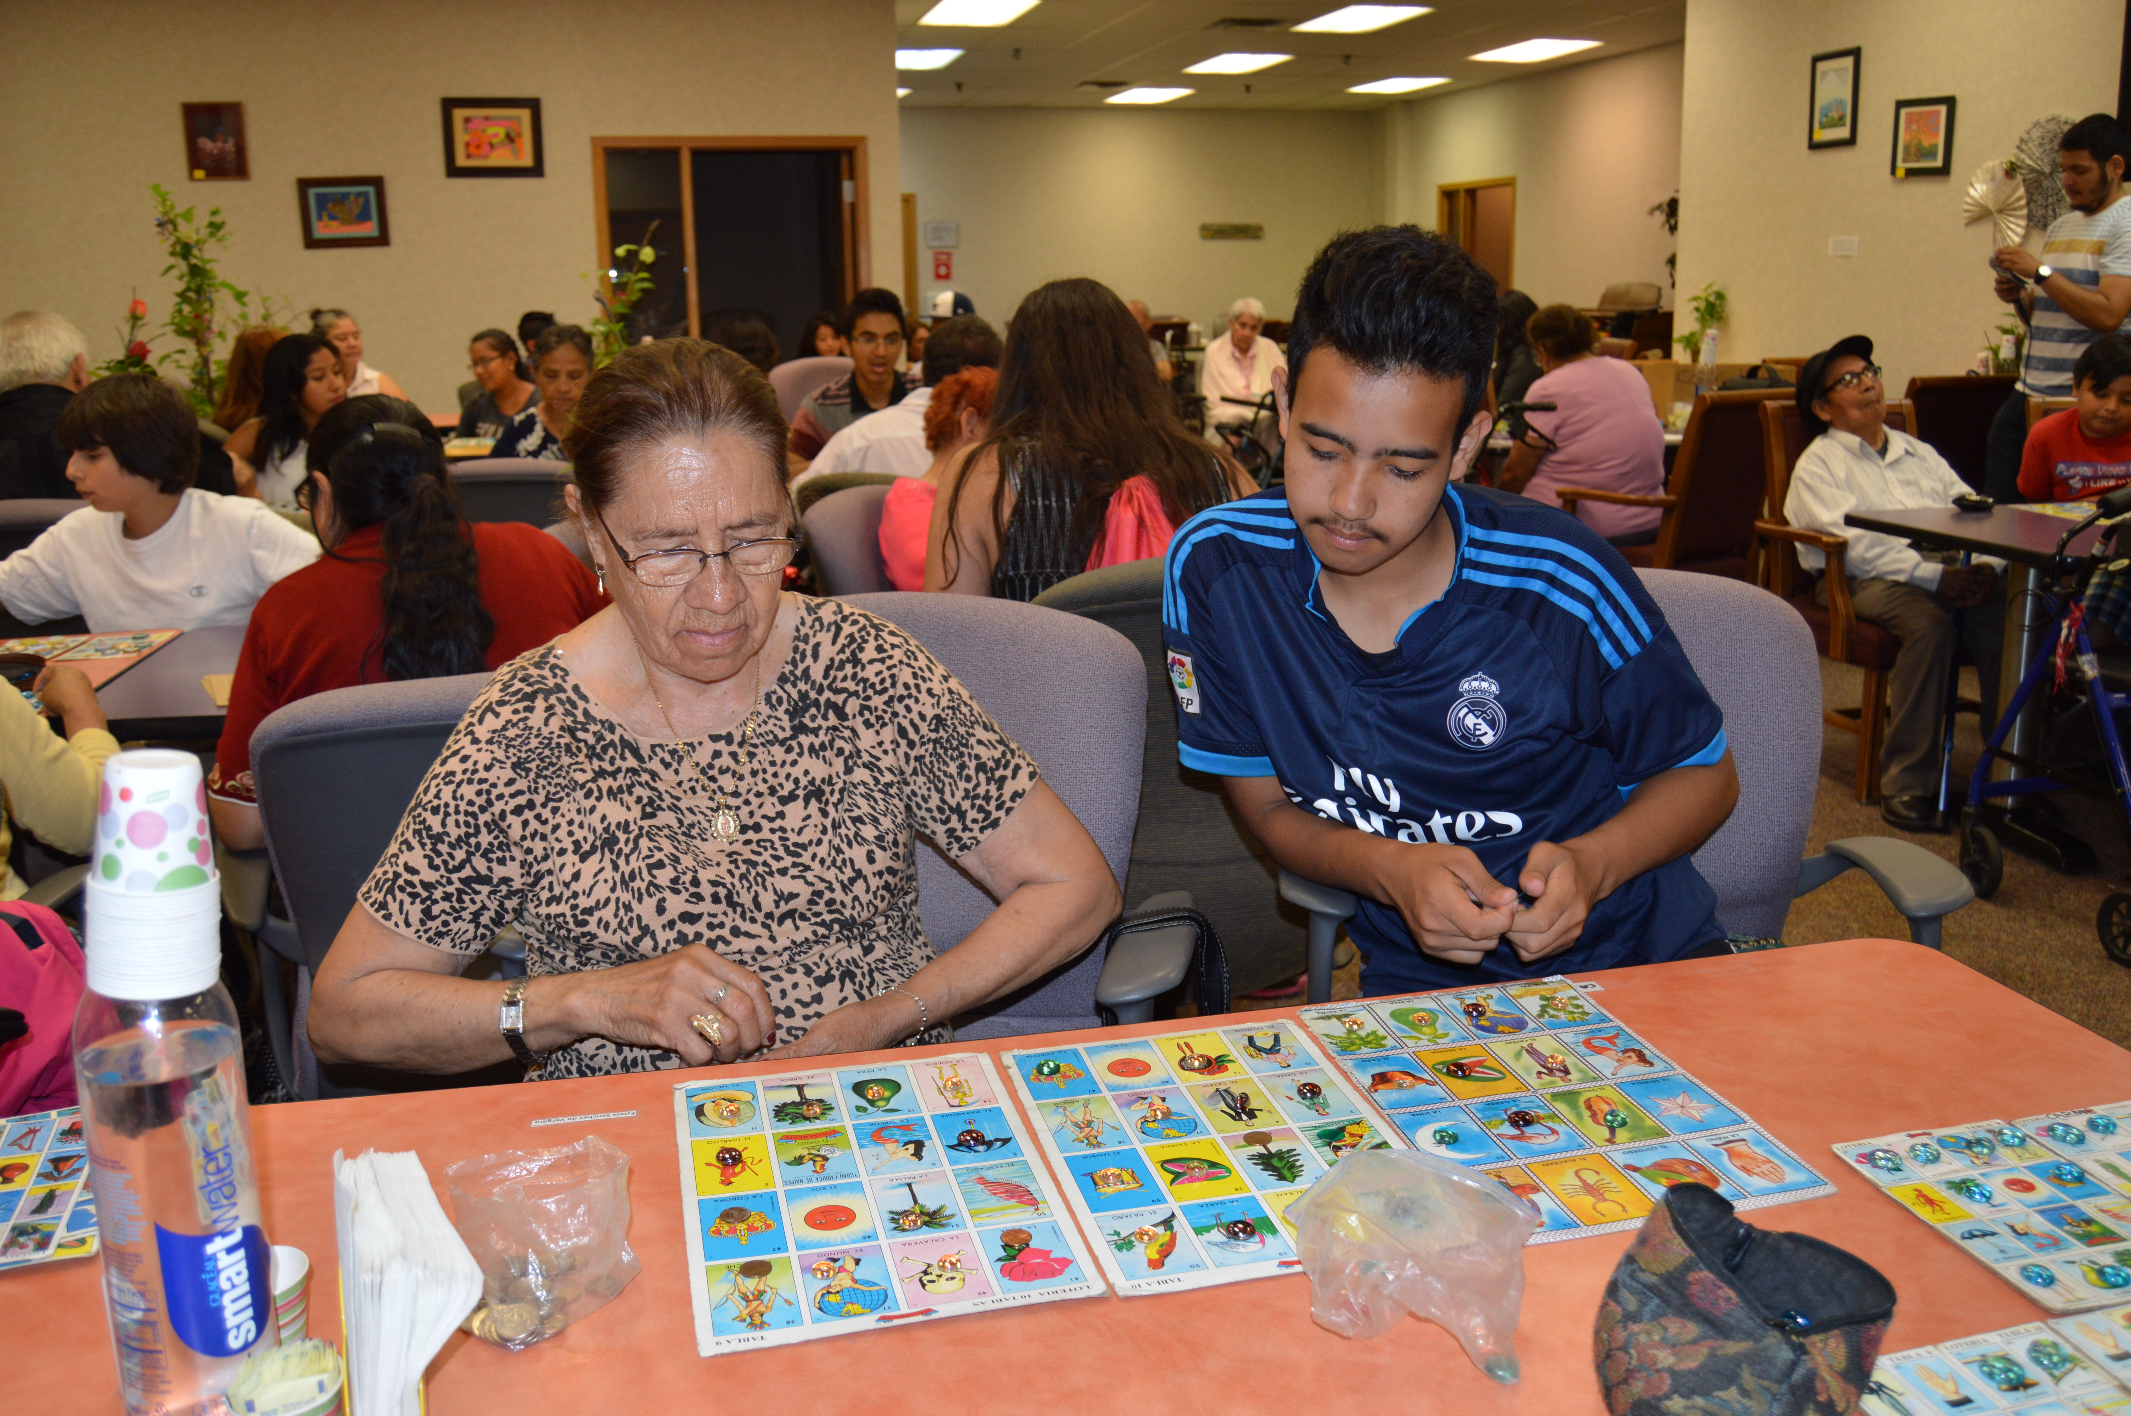
Centro Tyrone Guzman Programs
EARLY CHILDHOOD - YOUTH - ADULT & AGING
Montessori influenced, intergenerational
and holistic approach
Our programs have a broad definition
of well being that includes:
Physical
Mental
Spiritual
Social

Slide 7
What motivates youth?
Chat Waterfall

Slide 8
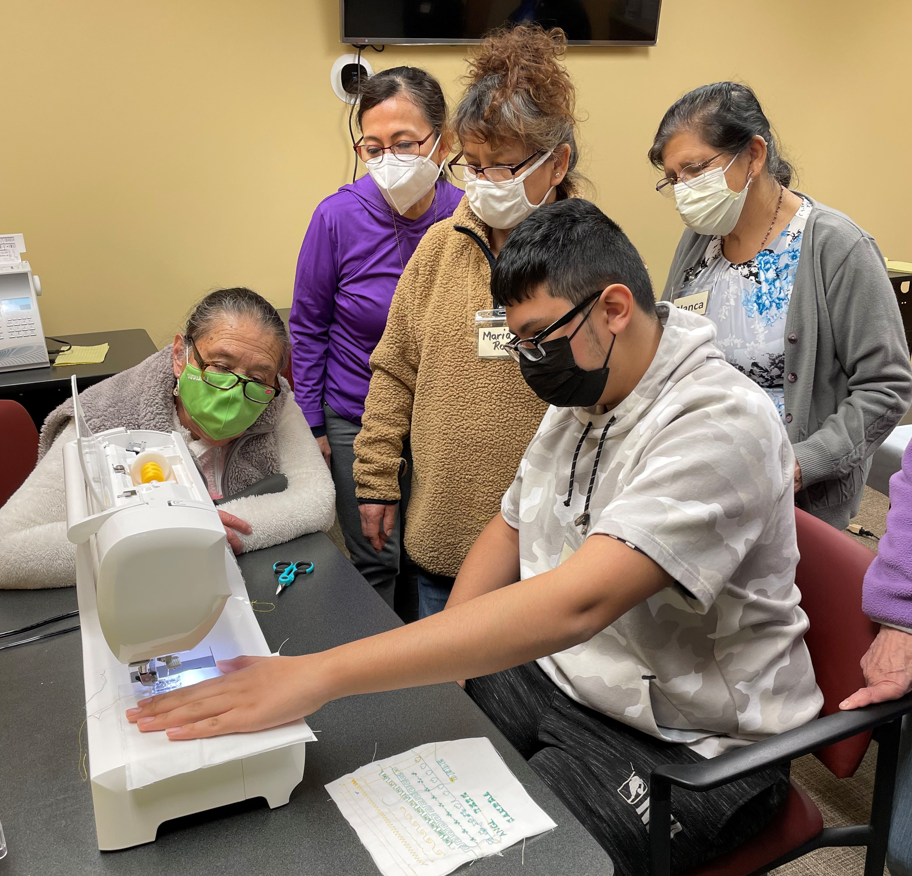
Manos Montessori (Montessori Hands) Intergenerational Microenterprise:
In the Manos Montessori Microenterprise, youth work with elders to develop, produce, and sell original Montessori Education Boxes, which are filled with Montessori-based learning activities that families can do with their young children at home.
Our intergenerational microenterprise is designed to support program participants (youth and elders) who want to:
Learn a skill
Share their wisdom / contribute to their community
Share with peers / reduce their isolation
The program is Montessori influenced so each participant is encouraged to learn at their own pace.

Slide 9
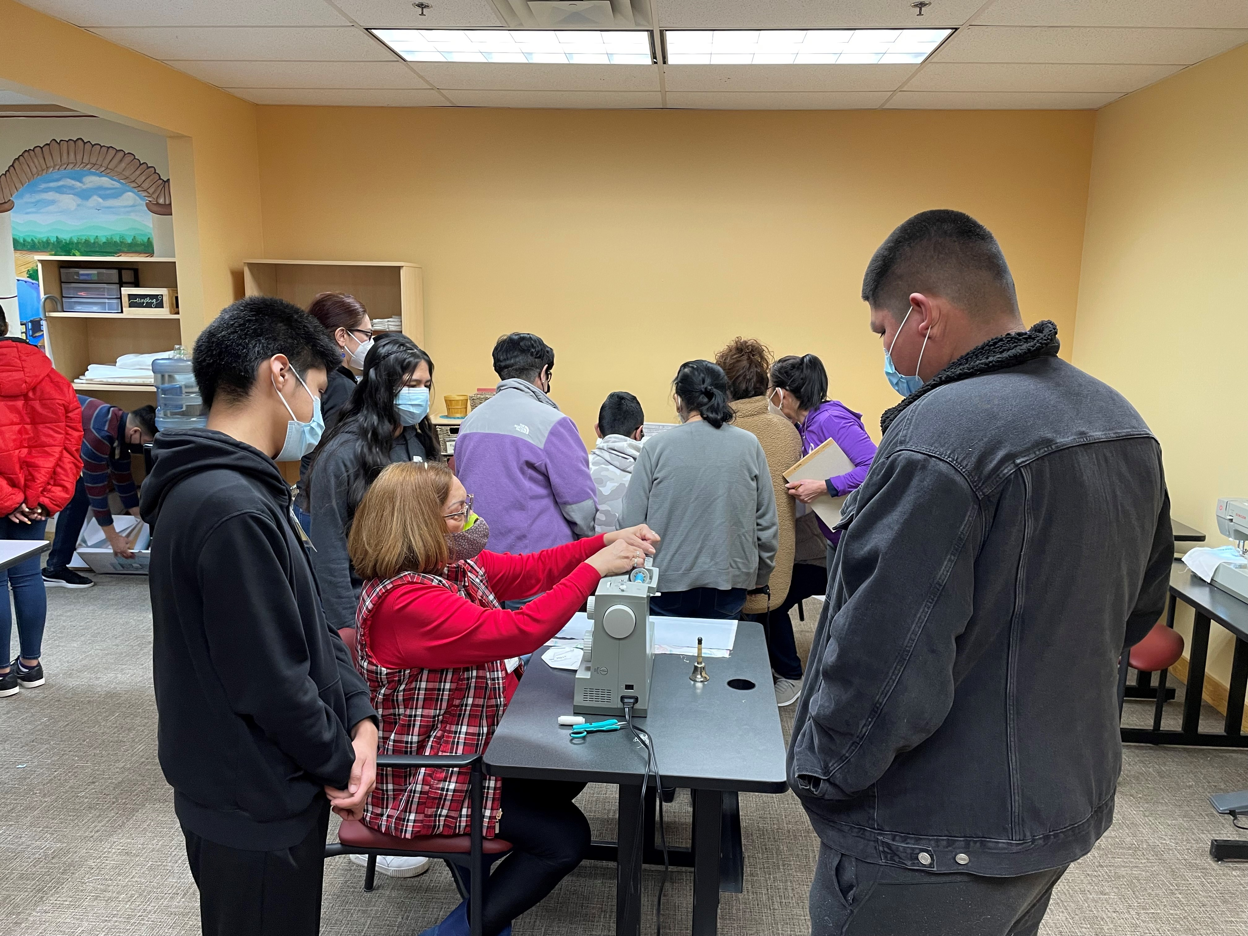
Manos Montessori (Montessori Hands) Intergenerational Microenterprise:
Through the microenterprise, youth develop academic and life skills, while building relationships with peers and elders.
Our coordinators help youth look forward by preparing for college/careers, while their elders help them gain a greater understanding of their past.
As youth teach elders skills, such as technology and social media, they practice important life skills like self-expression and sequential thinking.
Youth and elders participate together in trainings in a variety of areas, such as teamwork, public speaking, sewing, and budgeting.

Slide 10
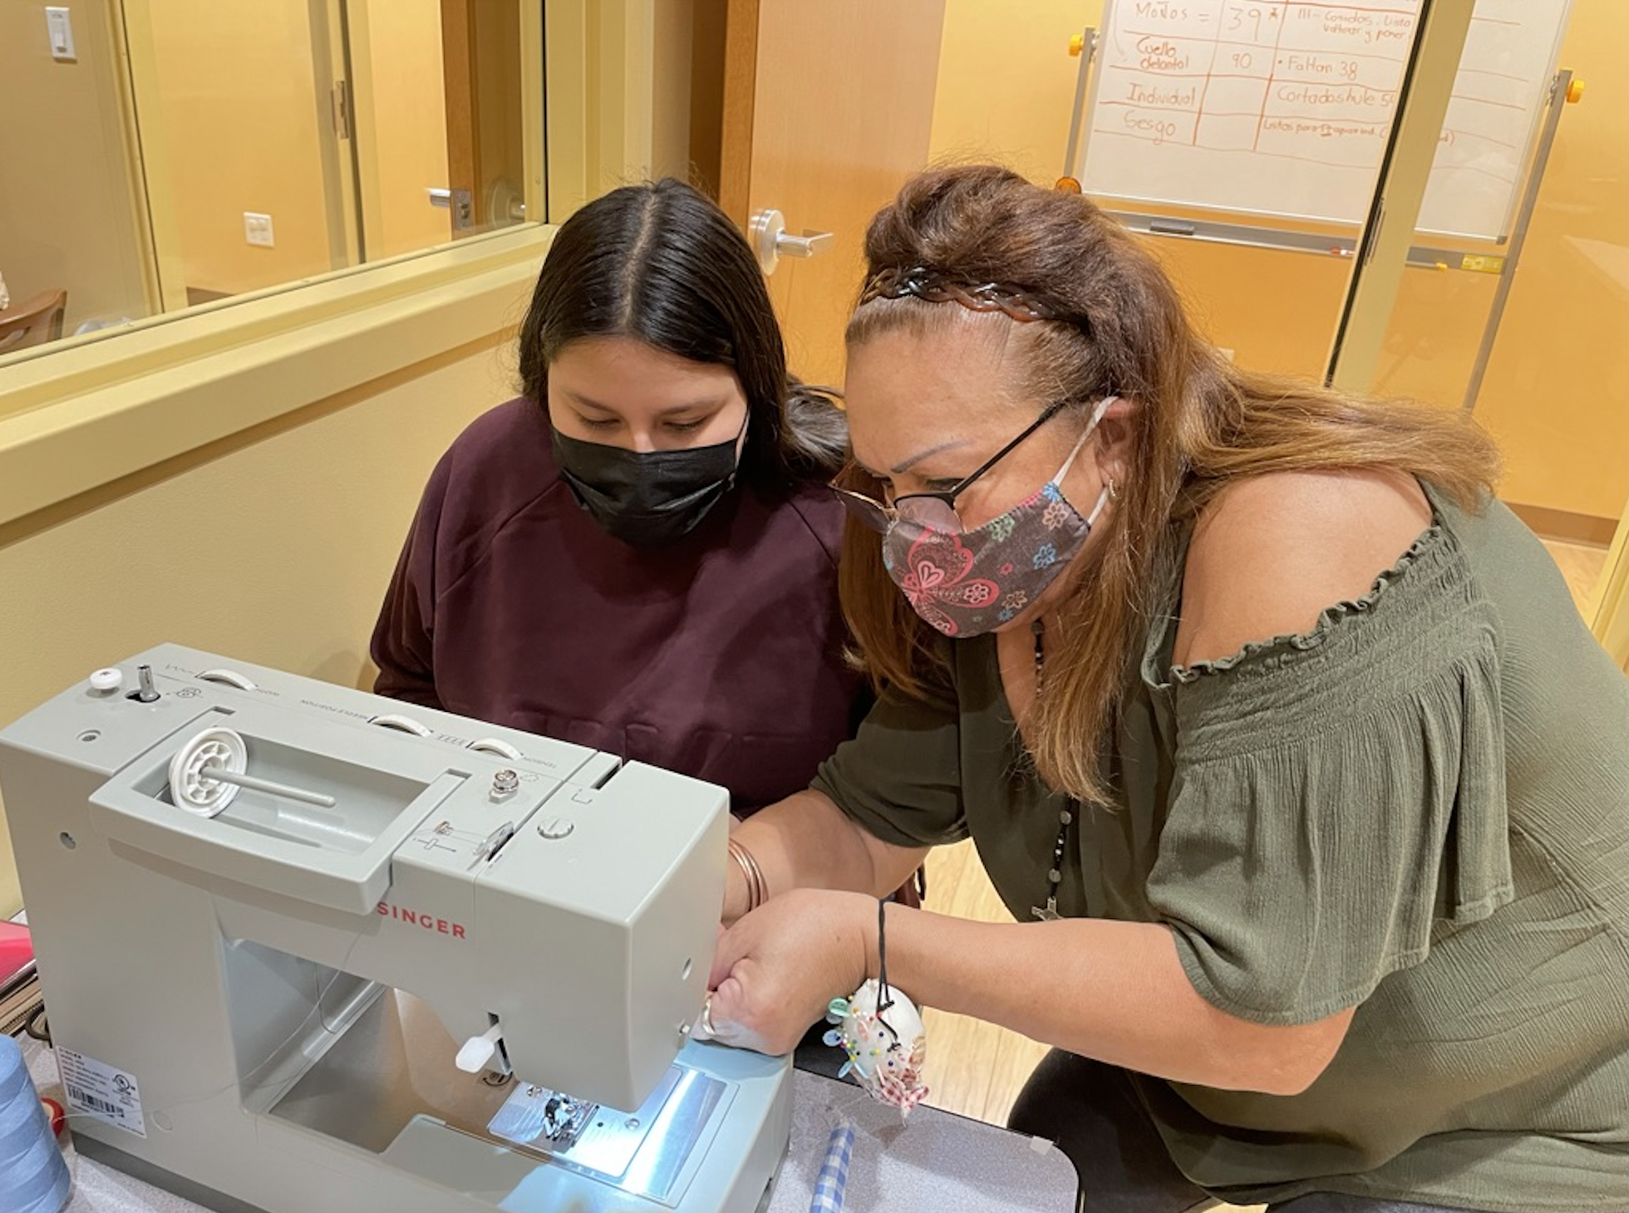
Manos Montessori (Montessori Hands) Intergenerational Microenterprise:
When youth and elders work collaboratively toward shared goals, participants of all ages build a sense of connection and contribution to their community.

Slide 11
THANK YOU!

Slide 12
EMERGE
Will Wallace

Slide 13
Health Start School Based Clinics A program of Minnesota Community Care

Slide 14
Beginnings First an MIC Program Many prenatal patients were teens who were not keeping their appointments So the Team went to the teens

Slide 15
Not just pregnant teens who needed care Others presented with more health issues So……….

Slide 16
We packed up
We began seeing students in the school across the street. Our first clinic was a renovated janitor’s closet

Slide 17
First ever
In 1973 Health Start opened the first IN SCHOOL clinic at Mechanic Arts H.S.
Today we have clinics in 10 schools

Slide 18
We belong to the National Assembly of School Based Clinics since the inceptions
of that entity We are NOW part of the new Minnesota Assembly of School Based Clinics

Slide 19
Who do we serve? 4000 unique clients each year Many remain after graduation Open to adolescents 13-22 whether
in school or not

Slide 20
In addition
We teach Comprehensive Human Sexuality
in 3 community schools and many of those
students use our clinic services as well

Slide 21
Influencing Health of the Community
In communities with SBCs, health status
of teens is vastly improved
In communities without, teens tend to
not have access to health care.

Slide 22
What makes an SBC work? Traditional barriers to health care are removed. Our long term Mantra:

Slide 23
AAA

Slide 24
AAA
Accessible We bring services to young people No transportation needs or costs No time away from school Parents do not need to miss work to
bring their child to a health facility

Slide 25
AAA
Available We’re there when they are 3 school clinics stay open year round No cost to students or their families

Slide 26
AAA
Acceptable Teen friendly ( no running into Auntie) Inclusive Confidential In the absence of judgement All staff have training, background and
experience in adolescent development
and working with teens

Slide 27
Comprehensive Care Integrated Team
Medical Providers
Behavioral Health with licensed therapists
Registered Dietitians aided by a Fitness
Instructor
Health Educators

Slide 28
Health Educators
Reproductive Health
Decision Making
Risk Reduction
Stress Management
Self Advocacy

Slide 29
Support Clinic Coordinators Medical Assistants

Slide 30
And….. Part of the fabric of the school. Teaching in the classrooms Participating in school activities Growth and change happens within
the context of relationship. As a team we build relationships with the
young people we serve that last throughout
their school years and often beyond.

Slide 31
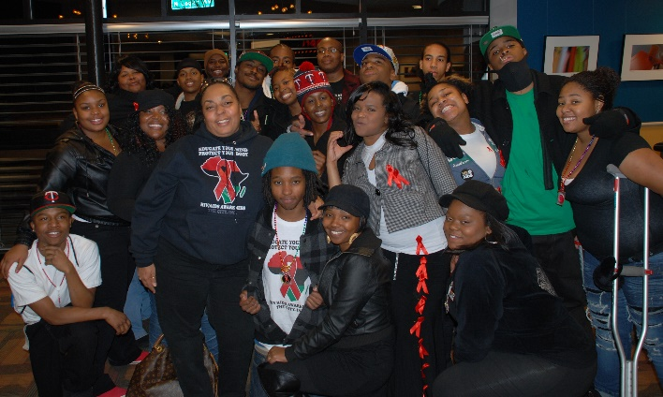
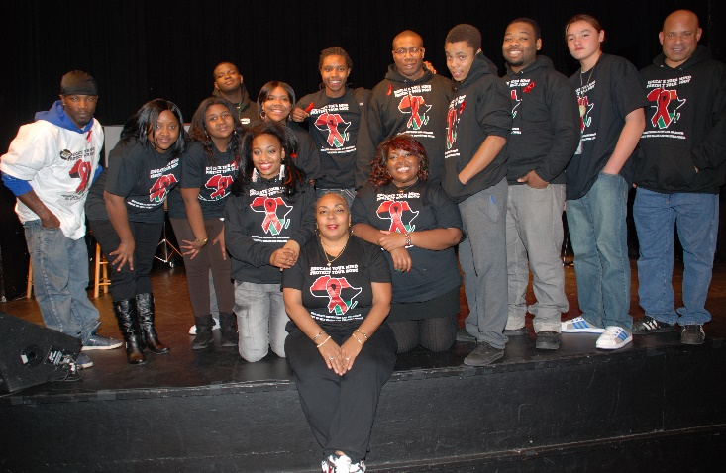
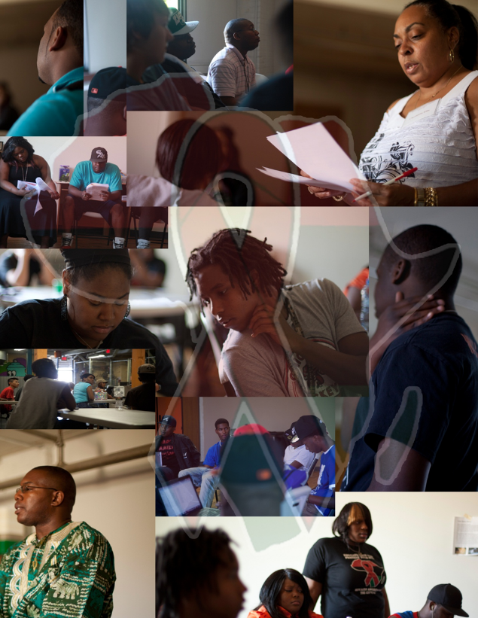
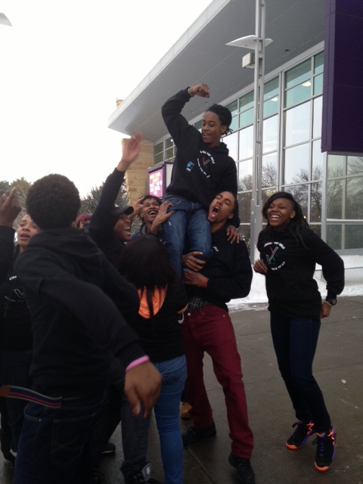
High School for Recording Arts - Check Yo’ Self Health & Wellness Center
Since 1992

Slide 32
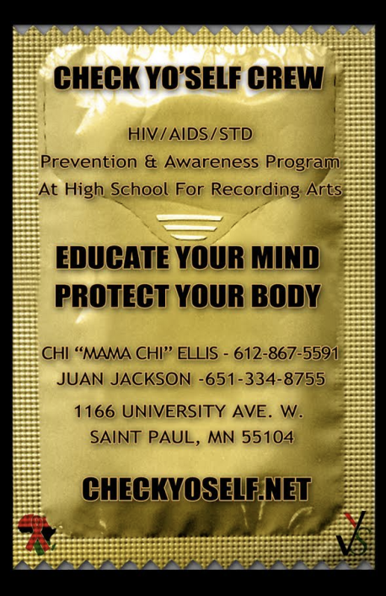
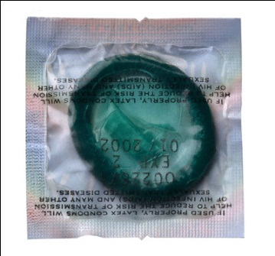
Up with protection, down with infection.
Teen Pregnancy HIV/AIDS/STI and Prevention and Eduction

Slide 33
Our Programs
HAS Program
High school students, male and female, ages 14-24, who participate in vigorous, exciting and imaginative classroom sessions in the areas of sexual health, science, personal finance, music, and other pertinent topics of the day.
Check Yo’ Self Crew
Peer educators, male and female, ages 14-24, who disseminate HIV/AIDS/STI and teenage pregnancy prevention information through social media, street outreach, and purpose-driven music.
SIHLE
African American females, ages 14-18, participate in a Center for Disease Control (CDC)-approved evidence-based curriculum used to facilitate a culturally-specific, peer-led, intervention program aimed at reducing HIV-risk behaviors.
Safer Choices
High school students, male and female, participate in a CDC-approved, evidence-based curriculum about HIV/STI and teen pregnancy prevention, building communication skills around delaying sex, and using condoms.
SHARP
High school students, male and female participate in an evidence-based intervention that incorporates videos, lecture, group discussion and activities to deepen STI/HIV knowledge, improve condom use, reduce teen pregnancy and alcohol use.
COVID-19
Health Education and Health Promotion
Use social media and community outreach increase education about vaccination, testing, and prevention of COVID-19.

Slide 34
Youth Advocacy
Experiential

Slide 35
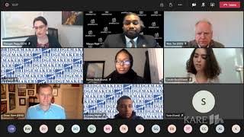
MN Unemployment Law Challenged
News Story: High school students receive unemployment benefits, now the state wants the money back
https://www.youtube.com/watch?v=3tDWP29Doas&t=44s
News Story: Minnesota Court of Appeals allows high school students to receive pandemic unemployment assistance
https://www.youtube.com/watch?v=FCW95F4msKE
Panel: Pandemic unemployment assistance for Minnesota youth
https://www.youtube.com/watch?v=Zzo38PQTCpk&t=1s

Slide 36
Youth Advocacy – Public Health
Housing, Employment, Education, Transportation, Racism, Safety, and Access (social determinants)
Accountability
Peer to peer
MN Minor Consent Law
Legislator – elected official education

Slide 37
Questions
Centro Tyrone Guzman | Natty Hels (nhels@centromn.org)
EMERGE | Will Wallace (WallaceW@emerge-mn.org)
High School for Recording Arts | Juan Jackson (jjackson@hsra.org)
Minnesota Community Care | Sandy Naughton (ssnaugh@mncare.org)

